Slide 1
Week 12:
Java Streams (Functional Programming)
How Streams work
Using Streams

Slide 2
Immutable Objects
An immutable object is read only!
It can’t be changed after it is instantiated
There are two big advantages to Immutable objects:
Multi-threading - Since the internal state of an immutable object remains constant in time, we can share it safely among multiple threads.
We can also use it freely, and none of the objects referencing it will notice any difference, we can say that immutable objects are side-effects free.
A good rule of thumb is that, when possible, make everything that can be immutable!

Slide 3
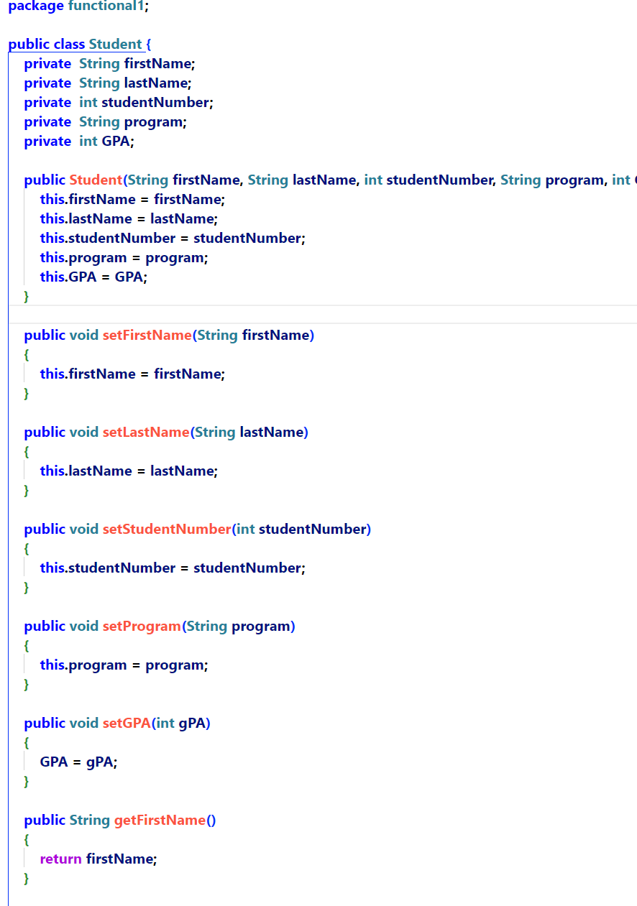
Making an object immutable
All instance variables must be made final
There are no setters whatsoever

Slide 4
Functional Programming

Slide 5
Introduction to functional programming
Unstructured – Assembly language, Basic: GOTOs
Procedural – breaks programs into manageable chunks called procedures (a lot like methods but no concept of an object) Data and behavior are highly decoupled.
OOP – encapsulates data and behavior into objects. Data and behavior are highly coupled. Much easier to build complex solutions that procedural.
Functional – passes data from function to function to get a result. Think of it like a Blackbox that we pass data into and get data out of. Functional programming wants to be stateless.

Slide 6
Unstructured programming
Assembly language etc.
Code is written as a single block.
GOTO commands are used extensively
Very difficult to read and maintain
Very few data types available to the programmer
Typically execute very quickly

Slide 7
Procedural Programming
Code is broken down into a series of files and subroutines
The algorithm, code and the sequence of actions are given priority and the data is thought of more as a by-product of the code.
Contrast that with OOP where the data is the center of attention, and the code is written to support the data.

Slide 8





OOP
Like building house using tradespeople.
Many different tradespeople, all working towards the same goal.
Each tradesperson performs a set of tasks and the tradespeople all talk to each other (message) in order to keep everything moving forward.
Things that one tradesperson does, impacts other tradespeople.
For example, where the electrician puts an outlet will affect how the drywaller installs the drywall and the painter can’t start painting until the drywall is installed. (In functional programming, we call these side-effects)
All tradespeople, working together, can build wonderous things!
However, things can go very wrong if one tradesperson changes the wrong thing at the wrong time!

Slide 9
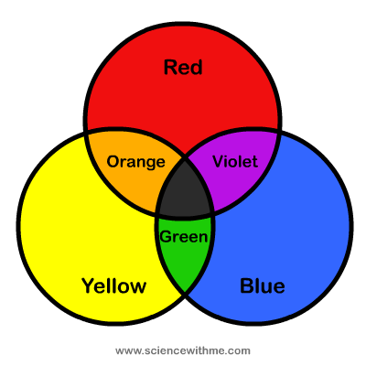

Functional Programming
Create no (very few) side-effects (using any particular function will not change the state of other parts of the program)
Each function does not alter the input going into it
Each function creates an output based solely on the inputs passed to it
We can chain together many functions to produce the desired output, given a set of inputs
Can chain them together in any order
Very easy to test our code

Slide 10
Which is better?
What is the sound of one hand clapping?
Let’s take a look at Java Streams
Notes:
The answer is that each is just a tool in your toolkit to solve problems. Everything is a tradeoff and, knowing about all of these approaches allows you to make the best decisions you can when attacking a problem.
Don’t make the mistake that many programmers make. Don’t get too attached to anything. Use the best tool for the job.

Slide 11
Introduction to Functional Programming
Until now, if we needed a method, we wrote it inside of a class and then we can called it from the object.
However, what if we just want to do one thing and we don’t need any instance variables etc?
We could make the method static, but we would still have to encase it in a class.
Functional programming allows us to build tiny units of work that don’t need to live in a class.

Slide 12
What the heck is a function and how is it different than a method?
A method is a set of instructions associated with an object. (Makes sense, right?)
A function is a set of instructions that is NOT associated with an object.
So, really, a method is a function that is associated with an object.
For many years, Java only supported methods.
As of Java 8, functions are supported
We call this functional programming

Slide 13
So, let’s think about that
If a function isn’t tied to a class (object) then functions can’t access any instance variables.
Functions can only take information in and return information out.

Slide 14
Introducing Streams
atasteofstreams - PartA

Slide 15
OK, we have a fair bit to unpack
First, what is a Stream?
“Java streams enable functional-style operations on streams of elements. A stream is an abstraction of a non-mutable collection of functions applied in some order to the data. A stream is not a collection where you can store elements.”
Ok, that didn’t help…
Read only (Can’t be changed)

Slide 16
Java Stream
Is a structure that is capable of iterating (looping) over each of its elements
Provides functionality to allow intermediate processing its elements in different ways
Collects the results without ever changing the original structure that the stream was created from

Slide 17
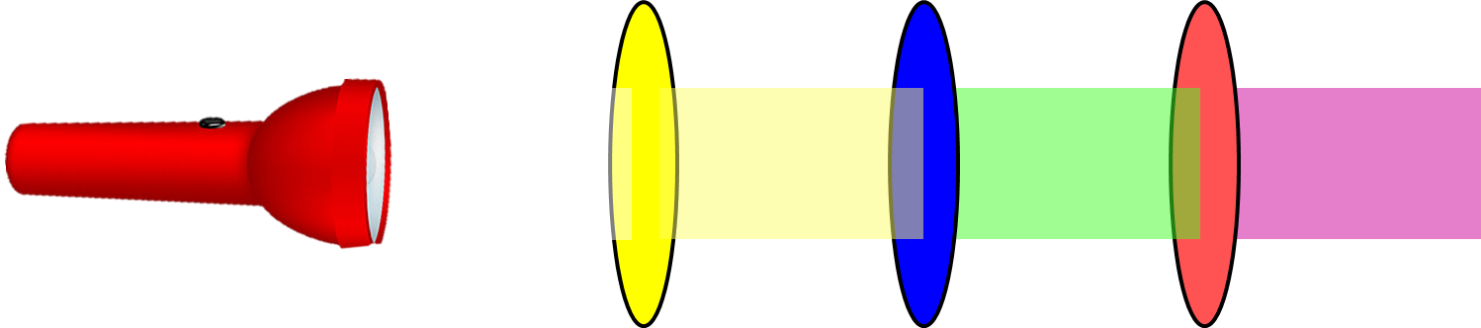
How do we use a Stream?
Obtain a Stream
We call this a Stream ‘pipeline’
First, we obtain a Stream,
Then apply as many non-terminal operations as we wish
Finally, we apply a terminal operation to complete the pipeline
Non-terminal operation
filtering
Non-terminal operation
transforming
. . .
sorting
etc
Remember, each ‘lens’ in the pipeline, doesn’t change anything that came before it, and provides a new Stream to the next ‘lens’
Non-terminal operation
Call a terminal operation on the Stream

Slide 18
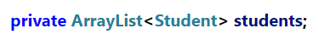
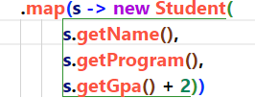
How do we use a Stream?
Obtain a Stream
Non-terminal operation
filtering
Non-terminal operation
transforming
. . .
sorting
etc
Non-terminal operation
Call a terminal operation on the Stream
OR

Slide 19
We can add as many non-terminal operations as we like
filter()
map()
distinct()
limit()
sorted()
flatMap()
peek()

Slide 20
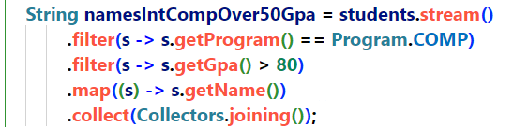
How can we just keep adding in new non-terminal operations to the stream?
Spoiler Alert: We don’t!
Each non-terminal operation returns a new Stream*
* And remember, when we say returns a new Stream, what we are really saying is that it is returning the address of a new Stream object so we can use (dot notation) to call any method in the new Stream object
Returns a Stream
(previous Streams are immutable)

Slide 21
We have only 1 terminal operation
forEach()
collect()
count()
findFirst()
min()
max()
toArray()
anyMatch()
allMatch()
noneMatch()
findAny()
reduce()

Slide 22
Yourturn1-Part A
10 mins

Slide 23

Here’s the thing – It isn’t magic!
We already know everything that is needed to understand how Streams work!
Anonymous classes
Functional Intefaces
Lambdas
Syntatic Sugar

Slide 24
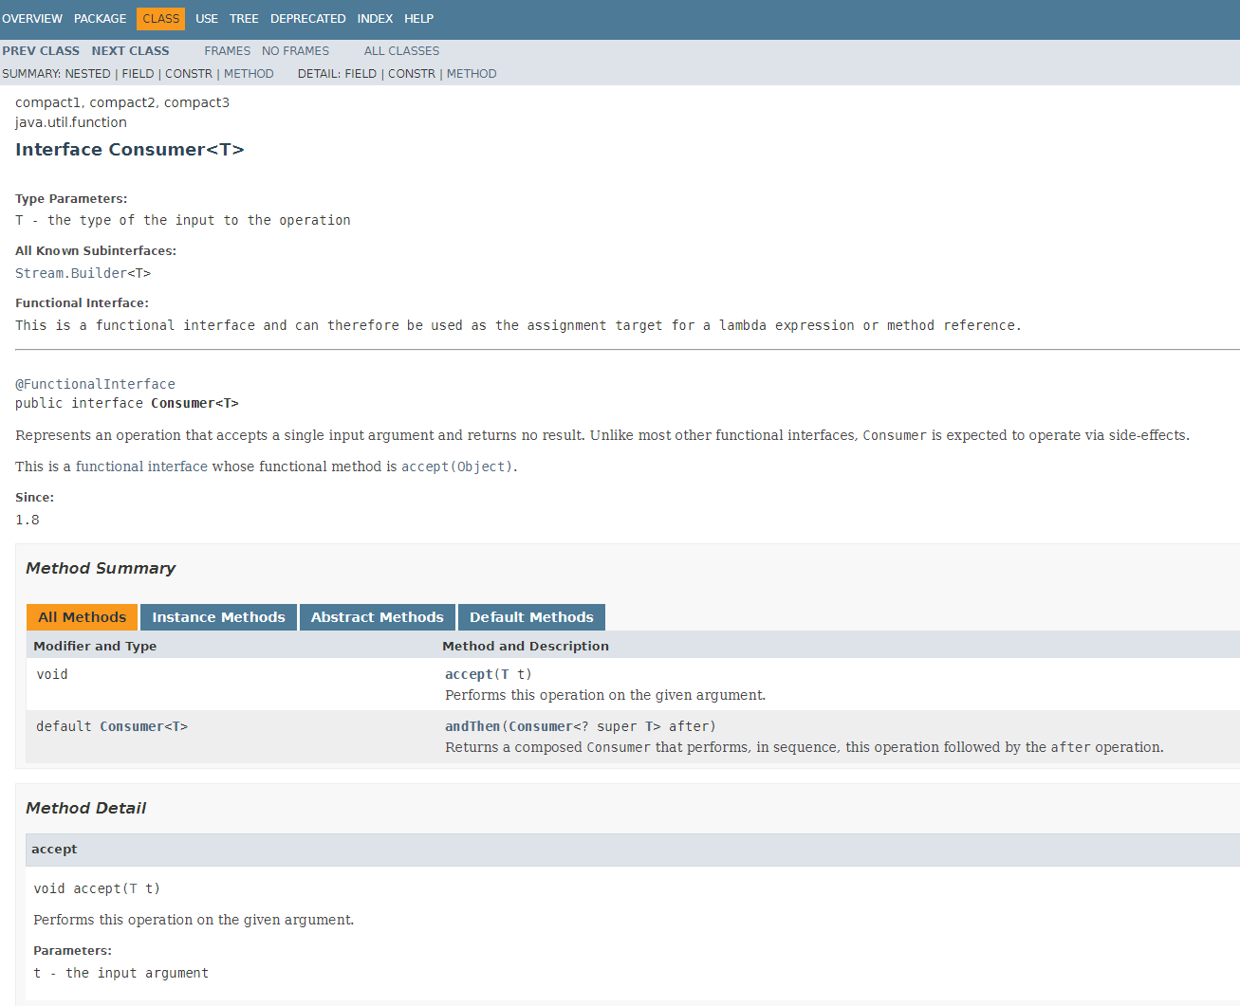
OK, but how does it WORK? What has it got to do with functional interfaces?
Let’s look at…
The Consumer Interface…

Slide 25
But how do they work?
atasteofstreams – Part B

Slide 26
So, Streams are just…
Functional interfaces (an interface with only one abstract method)
Anonymous classes
Lambdas
A bit of syntactic sugar
Huh? Who would have thunk it?
Notes:
Basically, Streams are built upon the principles that we learned about in the last section:
Create a functional interface (In this case, the Streams code gives us interfaces such as Consumer etc)
Build an anonymous class to implement that interface
Use lambdas to pretty it all up

Slide 27
Yourturn1-Part B & C

Slide 28
Uh oh… Revenge of equals and hashcode
atasteofstreams – Part C

Slide 29
Yourturn1-Part D

Slide 30
Sorting
This is where functional programming really shines.

Slide 31
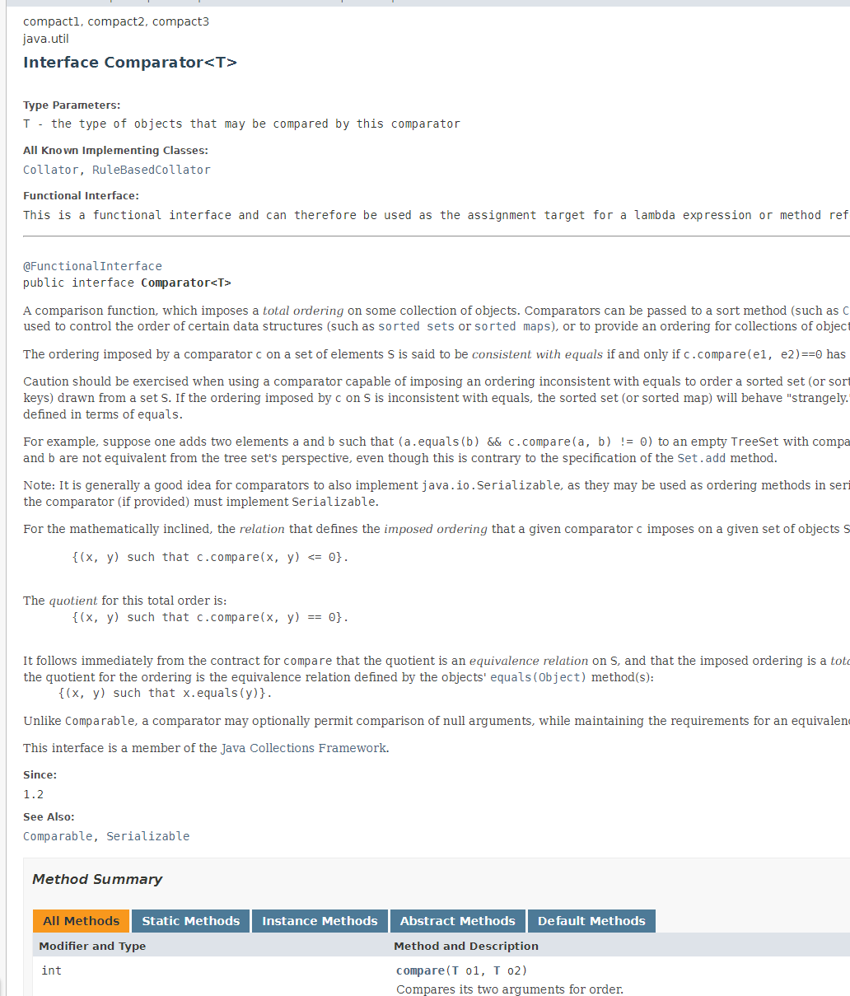
Comparator functional interface
Takes two arguments
Returns a negative int if first argument should come first, a positive int if the second argument should come first, and 0 if they are to be considered the same

Slide 32
Sorting!
atasteofstreams – Part D

Slide 33
Yourturn –Part E

Slide 34
Map
Map lets us take our stream and map it into another stream without changing the original collection.
For example, we can start out with a stream of Student and map it to a stream of <Integer> containing all of the gpa values

Slide 35
Using map
atasteofstreams – Part D

Slide 36
System.out::println
The double colon (::) operator, also known as method reference operator
Can be used to refer to
A static method
An instance method
A constructor
This is another example of Syntatic Sugar. We won’t cover this in this course but it can be, on occasion, useful to make code more readable.
Notes:
This is optional

Slide 37
Method Reference Operators
Methodreferenceoperators - Start

Slide 38
Yourturn2

Slide 39
Yourturn3

Slide 40
Rich
Complete yourturn 2 and morestreams

